Slide 1
Multicollinearity
A predictor variable may be redundant, in the sense that it “overlaps” with other variables. That is, it can be predicted well by other predictor variables and doesn’t add much new to the model.
For example, suppose we have two species, giants and dwarves. We are interested in blood pressure (Y) with race (X₁) and height (X₂) as the predictors.
These predictor variables are redundant. That is, they explain the same thing.
The variation in blood pressure that is explained by what species a person is will greatly overlap with the variation in blood pressure that is explained by height of the individual.

Slide 2
Multicollinearity
There is a high level of correlation between X₁ and X₂.
Note, we could use height (X₂) to predict race (X₁).
This high level of correlation between predictors can lead to multicollinearity, which can lead to many problems.

Slide 3
Multicollinearity
We will first examine a situation where the predictor variables are not correlated.
Consider an experiment on the effect of work size crew (X₁) and level of bonus pay (X₂) on crew productivity (Y).
The predictor variables are uncorrelated.
The following tables contain the fitted regression function and ANOVA table for both X₁ and X₂ in the model, for only X₁ in the model, and for only X₂ in the model.

Slide 4
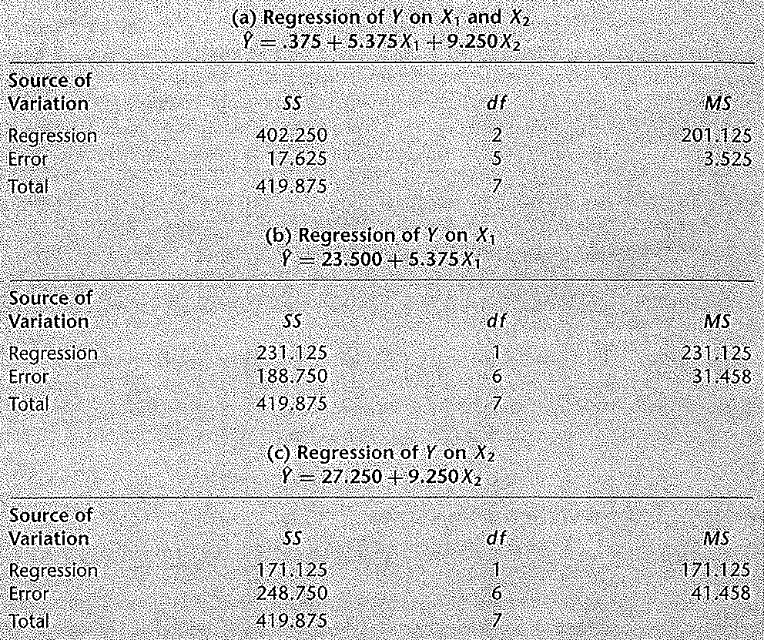
Multicollinearity

Slide 5
Multicollinearity
Note that the regression coefficient for X₁, b₁ = 5.375, is the same whether only X₁ is included in the model or both X₁ and X₂ are in the model.
Note also, that the regression coefficient for X₂, b₂ = 9.25, is the same whether only X₂ is included in the model or both X₁ and X₂ are in the model.
This is the result of both predictor variables being uncorrelated.
Thus, when the predictor variables are uncorrelated, the effects attributed to them are the same no matter which other predictor variables are in the model.

Slide 6
Multicollinearity
The extra sums of squares for adding X₁ given X₂ is already in the model, SSR(X₁|X₂), equals the regression sums of squares when only X₁ is in the model, SSR(X₁).
SSR(X₁|X₂) = SSE(X₁) – SSE(X₁,X₂) = 248.75 – 17.625 = 231.125
SSR(X₁) = 231.125
Similarly, the extra sums of squares for adding X₂ given X₁ is already in the model, SSR(X₂|X₁), equals the regression sums of squares when only X₂ is in the model, SSR(X₂).
In general, when two or more predictor variables are uncorrelated, the marginal contribution of one predictor variable when the other predictor variables are in the model is exactly the same as when this predictor variable is in the model alone.

Slide 7
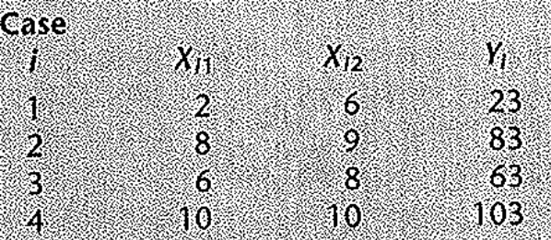
Multicollinearity
Equivalently, the proportion of variation accounted for by adding a predictor variable into a model, given the other predictor variables are already in the model, is exactly the same as the proportion of variation accounted for when this predictor variable is in the model alone.
To demonstrate the problems of multicollinearity, we will consider a case where two predictor variables are perfectly correlated.
For our example, we have 4 sample observations

Slide 8
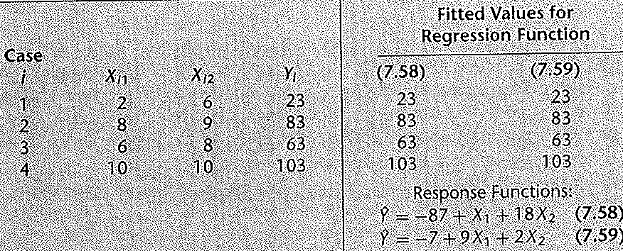
Multicollinearity
A first order regression function can be fit to this data producing the results Y(hat) = - 87 + X₁ + 18X₂. This turns out to be a perfect fit.
However, another fit is Y(hat) = - 7 + 9X₁ + 2X₂ which is also a perfect fit.

Slide 9
Multicollinearity
There are infinitely many possible ways to fit the data perfectly. This is a result of the fact that the predictor variables X₁ and X₂ are perfectly correlated.
X₂ = 5 + .5 X₁
Technically, multicollinearity is present in multiple regression when the columns of the X matrix are exactly or approximately linearly dependent.
That is, multicollinearity is present when the predictor variables are linearly related.

Slide 10
Multicollinearity
Multicollinearity can cause serious numerical and statistical difficulties in fitting the regression model unless “extra” predictor variables are deleted.
For example, if income, expenditures, and savings are used as predictor variables, then there is an obvious linear relationship between them, savings = income – expenditures.
Therefore, only two of them should be considered for inclusion in the model.
For another example, suppose that a regression equation is to be developed to model the cleaning effectiveness of a laundry detergent as a function of percentages of different ingredients.

Slide 11
Multicollinearity
The individual percentages add up to 100%, so one of the ingredients should not be included in the model.
Recall that the least squares estimators are b = (X’X)⁻¹ (X’Y).
If the columns of X are approximately linearly dependent, then X’X is nearly singular (not invertible).
When X’X is nearly singular, b is not unique or computable and our estimates b are numerically unstable.

Slide 12
Multicollinearity
Also, when X’X is nearly singular, the matrix (X’X)⁻¹ has very large elements.
With σ²{b} = σ²(X’X)⁻¹, large elements of (X’X)⁻¹ leads to large variance terms of the least squares estimates b.
Large variance terms of the least squares estimates b cause small values of our t statistics which makes the least squares estimates b statistically nonsignificant.
We will consider an experiment where the response is heat evolved in calories during hardening of cement on a per gram basis (Y) and the predictors are the percentages of 4 ingredients: tricalcium aliminate (X₁), tricalcium silicate(X₂), tetracalcium alumino ferrite (X₃), and dicalcium silicate (X₄).

Slide 13
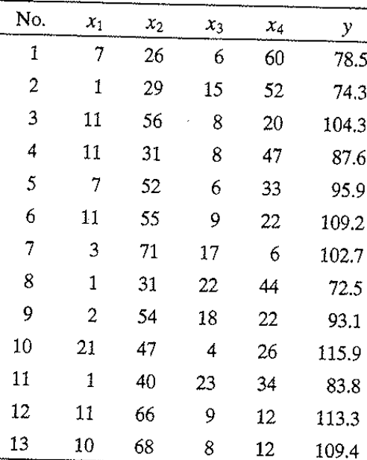
Multicollinearity
Above is the data and note that the predictor variables add up to approximately 100% for all observations (X₁ + X₂ + X₃ + X₄ ≈ 100%).
This approximate linear relationship among the X’s results in multicollinearity.

Slide 14
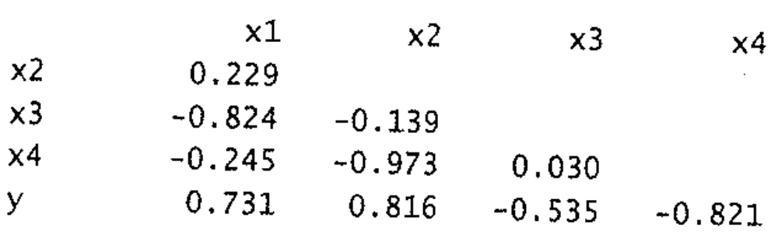
Multicollinearity
Above is the correlation matrix for the 5 variables. Note that X₁ and X₃ have a high negative correlation as do X₂and X₄.
The regression equation is
Y = 62.4 + 1.55X₁ + .51X₂ + .102X₃ - .144X₄.

Slide 15
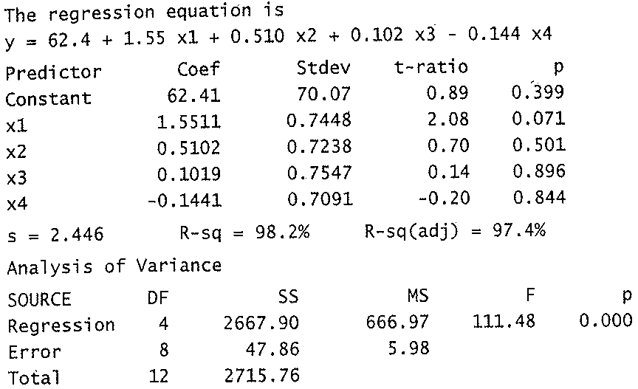
Multicollinearity
Above is the ANOVA table. Note the overall F test is highly significant with a p-value of approximately 0.
However, none of the coefficients are significant. That is, we rejected that all the β_{k} = 0 in the overall F test, but individually, we fail to reject that any of the β_{k} are 0.

Slide 16
Multicollinearity
Note, the ANOVA table is giving type 3 Sums of squares for the individual β_{k}. These give the extra sum of squares for adding a predictor variable, given the other variables are already in the model.
This is regardless of what sequence the variables are in. Here the Type III SS are:
SSR(X₁|X₂,X₃, X₄), SSR(X₂|X₁,X₃, X₄), SSR(X₃|X₁,X₂, X₄), and SSR(X₄|X₁,X₂, X₃)
Because of the correlation between X₂ and X₄, X₂ will not be significant given X₄ is already in the model, and vice versa.
The variation that would be explained by X₂ is already accounted for by X₄ if X₄ is already in the model.

Slide 17
Multicollinearity
Similarly, because of the correlation between X₁ and X₃, the results for testing their corresponding coefficient is zero is worse when the other predictor is already in the model.
Note, the standard errors of each estimate goes up and results are no longer significant, or are less significant, when its correlated predictor is also in the model.
SAS - multicollinearity

Slide 18
Multicollinearity
Several measures of multicollinearity are available. The simplest is the correlation matrix of the predictor variables.
If some bivariate correlations are high, linear relationships between the corresponding pairs of predictor variables are indicated.
However, linear relationships between more than two predictor variables do not always lead to large bivariate correlations and so these are hard to detect from the correlation matrix.

Slide 19
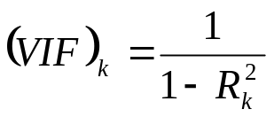
Multicollinearity
Multicollinearity is present when the predictor variables are linearly related. A measure of multicollinearity are variance inflation factors (VIF).
We have that
where R_{k}² is the coefficient of multiple determination when X_{k} is regressed on the remaining p-2 other predictor variables in the model.
If X_{k} is approximately linearly dependent on other predictor variables, then R_{k}² will be close to 1 and (VIF)_{k} will be large.

Slide 20
Multicollinearity
Generally, (VIF)_{k} values greater than 10, corresponding to R_{k}² > .9, are regarded as unacceptable.
SAS - multicollinearity

